Slide 1
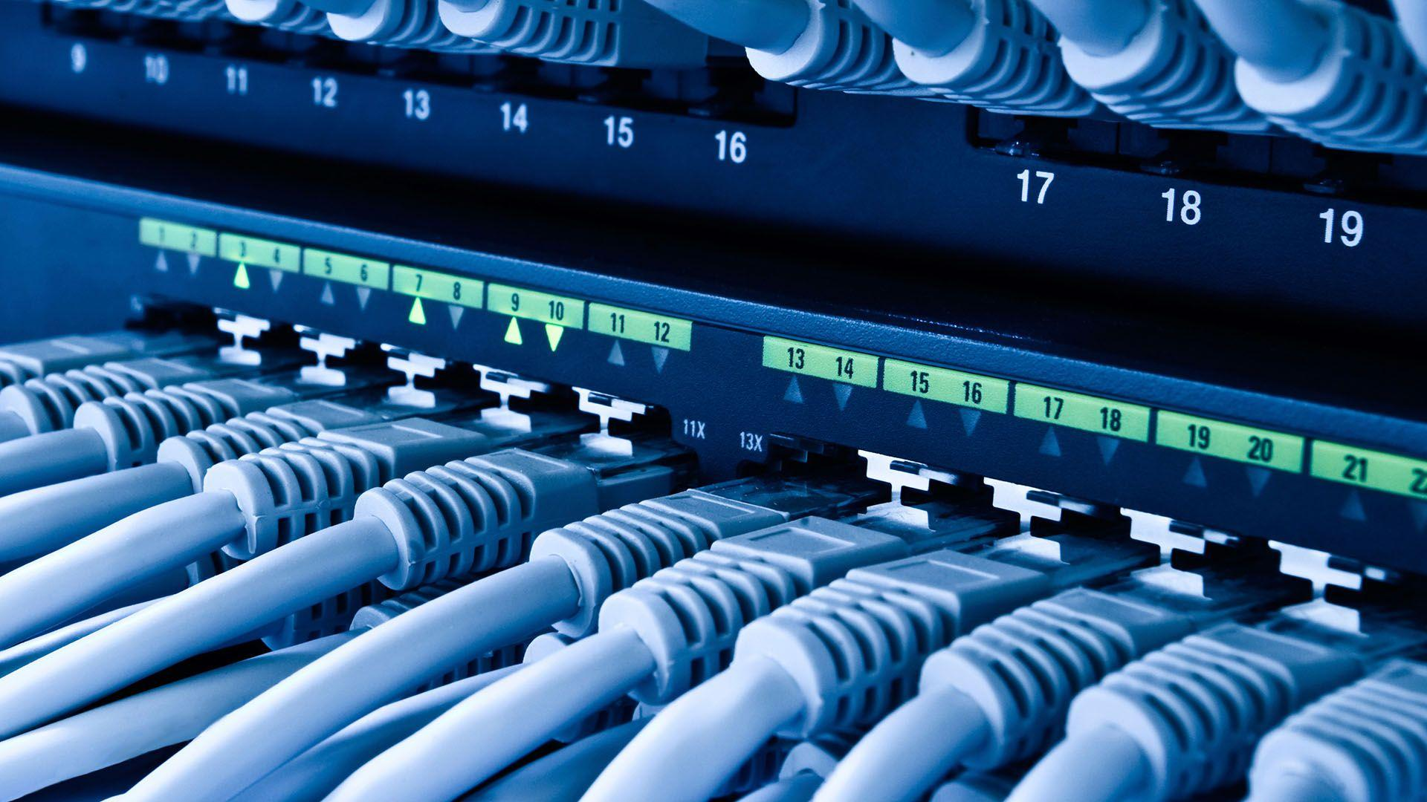
UNIT-II TCP/ IP Routing and Switching
Rajadhurai S
**Cyber Security Researcher**

Slide 2
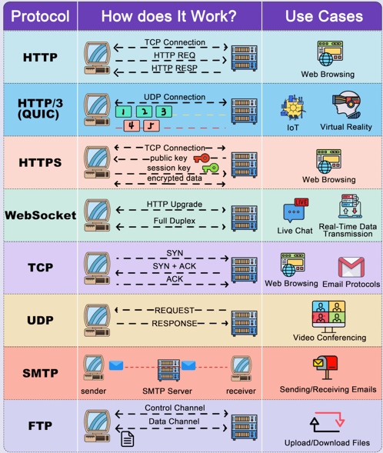
Agenda
Protocols and Common Ports
Subnet and CIDR
Router and Switches
Basic Routing Configuration

Slide 3
Common Port No TFTP – 69 (Trivial FTP – between Computer and Server) HTTP – 80 (Hyper Text Transfer Protocol) HTTPs – 443 (HTTP Secure) DHCP – 110 (Dynamic Host Configuration Protocol) NetBIOS- 135 / 139 (Network Basic Input/output System) SNMP – 161/162 (Simple Network Management Protocol) ICMP - (Internet Control Message Protocol)
FTP – 20, 21 (File Transfer Protocol)
SSH – 22 (Secure Shell Protocol)
TELNET – 23
SMTP – 25 (Simple Mail Transfer Protocol)
POP3 – 110 (Post Office Protocol)
DNS – 53 (Domain Name Server)

Slide 4
IP Address
192 | 168 |  | 100 |  | 225 |  |  | Note: IP address and default gateway are should be same Network. e.g., 192.168.100.225 192.168.101.225 (if it is changed the network or subnet not valid)
8 bit | 8 bit |  | 8 bit |  | 8 bit |  | 32 Bit
255 | 255 |  | 255 |  | 0 |  | Subnet mask
192 | 168 |  | 100 |  | 1 |  | Default Gateway
Group of 8 = 4 octet 192.168.100.225
5 Classes |  | 0-255 |  | 32bit |  | Network and Host IP

Slide 5
IP Address
192 | 168 | 100 | 1 | IP Address
11000000 | 10101000 | 01100100 | 11100001 | Binary Value
255 | 255 | 255 | 0 | Subnet Mask
11111111 | 11111111 | 11111111 | 00000000 | Binary
11000000 | 10101000 | 01100100 | 11100001 | Default Gateway
128 | 64 | 32 | 16 | 8 | 4 | 2 | 1 | Mask Value
1 | 0 | 0 | 0 | 0 | 0 | 0 | 0

Slide 6
Subnet Mask Hierarchy:
Subnet Mask | CIDR (Classless Inter- Domain Routing) | Binary Notation | Available Address/ Sheet
255.255.255.255 | /32 | 11111111 | 1
255.255.255.254 | /31 | 11111110 | 2
255.255.255.252 | /30 | 11111100 | 4
255.255.255.248 | /29 | 11111000 | 8
255.255.255.240 | /28 | 11110000 | 16
255.255.255.224 | /27 | 11100000 | 32
255.255.255.192 | /26 | 11000000 | 64
255.255.255.128 | /25 | 10000000 | 128
255.255.255.0 | /24 | 00000000 | 256

Slide 7
 | 128 | 64 | 32 | 16 | 8 | 4 | 2 | 1
255 | 1 | 1 | 1 | 1 | 1 | 1 | 1 | 1
254 | 1 | 1 | 1 | 1 | 1 | 1 | 1 | 0
252 | 1 | 1 | 1 | 1 | 1 | 1 | 0 | 0
248 | 1 | 1 | 1 | 1 | 1 | 0 | 0 | 0
240 | 1 | 1 | 1 | 1 | 0 | 0 | 0 | 0
224 | 1 | 1 | 1 | 0 | 0 | 0 | 0 | 0
192 | 1 | 1 | 0 | 0 | 0 | 0 | 0 | 0
128 | 1 | 0 | 0 | 0 | 0 | 0 | 0 | 0
0 | 0 | 0 | 0 | 0 | 0 | 0 | 0 | 0

Slide 8
Subnet Mask | CIDR (Classless Inter- Domain Routing) | Binary Notation | Available Address/ Sheet
255.255.254.0 | /23 | 11111110 | 512
255.255.252.0 | /22 | 11111100 | 1024
255.255.248.0 | /21 | 11111000 | 2048
255.255.240.0 | /20 | 11110000 | 4096
255.255.224.0 | /19 | 11100000 | 8192
255.255.192.0 | /18 | 11000000 | 16384
255.255.128.0 | /17 | 10000000 | 32768
255.255.0.0 | /16 | 00000000 | 65536

Slide 9
Subnet Mask | CIDR (Classless Inter- Domain Routing) | Binary Notation | Available Address/ Sheet
255.254.0.0 | /15 | 11111110 | 131072
255.252.0.0 | /14 | 11111100 | 262144
255.248.0.0 | /13 | 11111000 | 524288
255.240.0.0 | /12 | 11110000 | 1048576
255.224.0.0 | /11 | 11100000 | 2097152
255.192.0.0 | /10 | 11000000 | 41940304
255.128.0.0 | /9 | 10000000 | 8388608
255.0.0.0 | /8 | 00000000 | 16777216

Slide 10
Special or Reserved IP Address:
A special IP address refers to IP addresses that have specific,
predefined roles in networking and are not assigned to general devices.
On the Internet addressing architecture, the Internet Engineering Task Force and the
Internet Assigned Numbers Authority have reserved various Internet Protocol addresses
for special purposes
Loopback Address (127.0.0.0/8)
Purpose: Used by a device to refer to itself for testing and development purposes
Its commonly used for “Local Host” like 127.0.0.0/8
Private IP Address: reserved for use within private networks, not routable on the
Public internet its mostly used for intranet like Data Centre, Home Network, Offices.
Multicast and Broadcast Address

Slide 11
Tools for Troubleshooting IP Problems
IPCONFIG
IPCONFIG /ALL – Provide primary output with additional information's about network adapters.
IPCONFIG /RENEW – Used to renew the systems IP address.
IPCONFIG RELEASE- Remove the systems current ip address
Nslookup – NSLOOKUP command is used to troubleshoot network connectivity issues in the
systems using the nslookup command, we can access the information's related to
our systems DNS server i.e. Domain Name and IP Address.
PING – The Ping command as it allows the user to check the connectivity of
our system to another host. ping www.destination_host_name.com

Slide 12
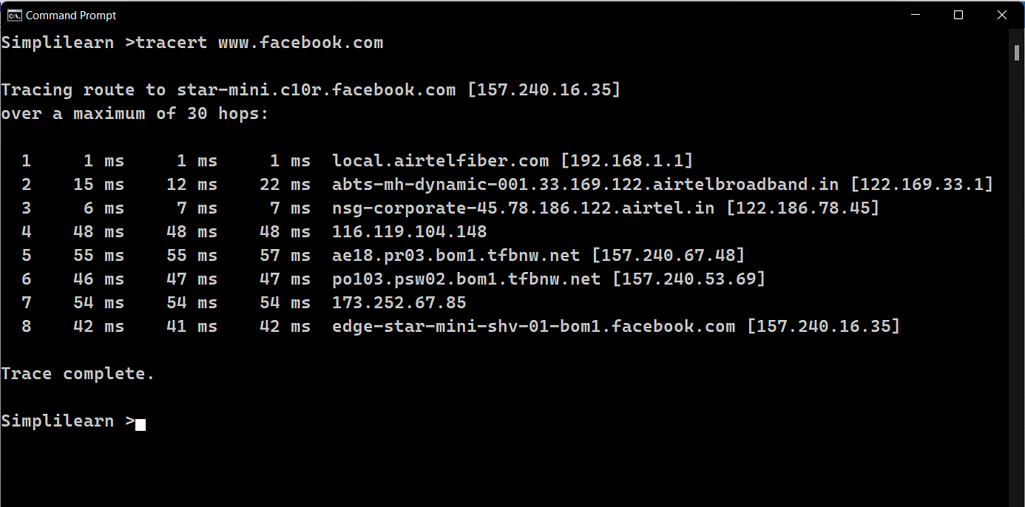
Tools for Troubleshooting IP Problems

Slide 13
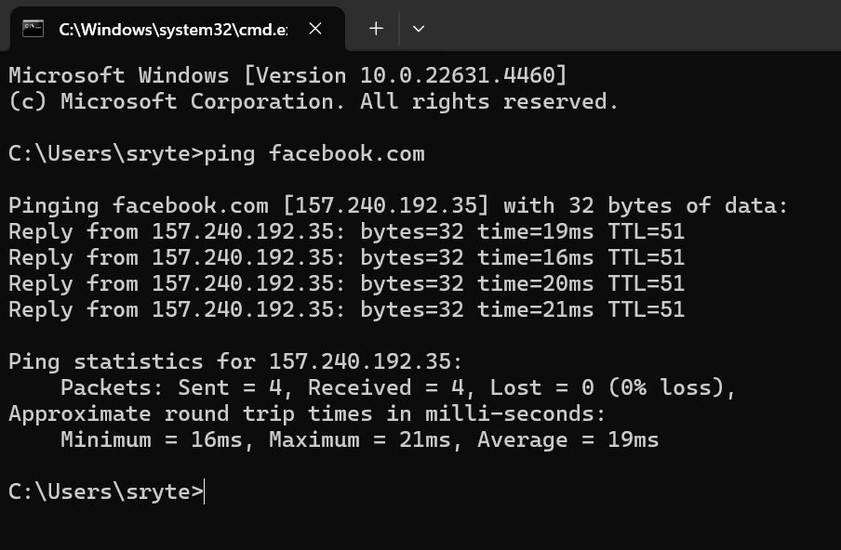
Tools for Troubleshooting IP Problems – PING

Slide 14
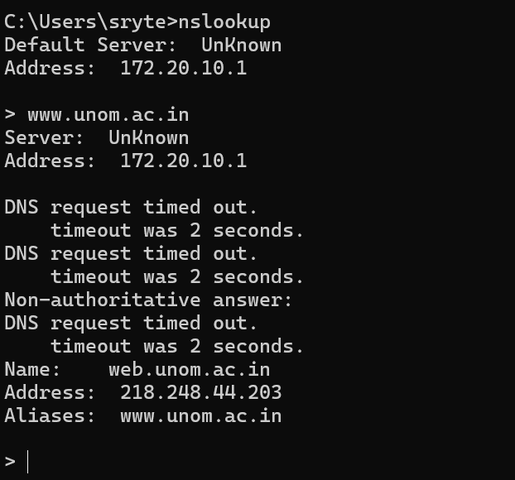
Tools for Troubleshooting IP Problems - NSLOOKUP

Slide 15
Tools for Troubleshooting IP Problems - Tracert

Slide 16
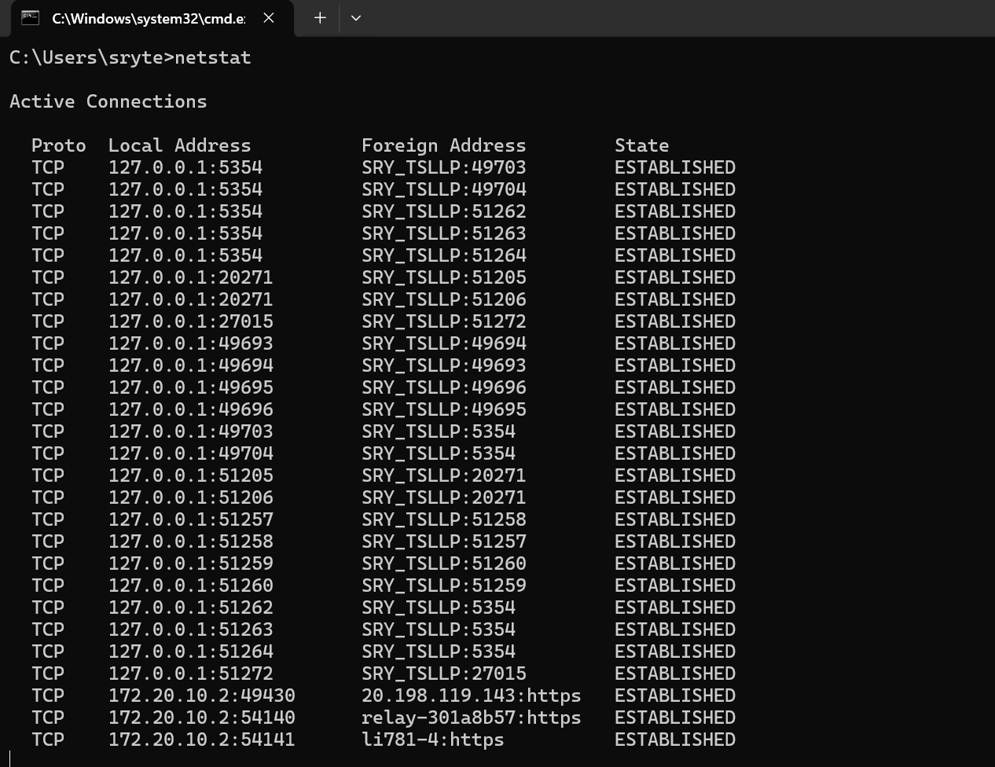
Tools for Troubleshooting IP Problems –
Netstat (The Netstat command as the name suggests displays an overview of all the network
connections in the device. The table shows detail about the connection
protocol, address, and the current state of the network.

Slide 17
Tools for Troubleshooting IP Problems - NSLOOKUP
ARP (Address Resolutions Protocol)-- The ARP command is used to access the mapping structure of IP addresses to the MAC address. This provides us with a better understanding of the transmission of packets in the network channel
Systeminfo- Using the SYSTEMINFO command, we can access the system’s hardware and software details, such as processor data, booting data, Windows version, etc.

Slide 18
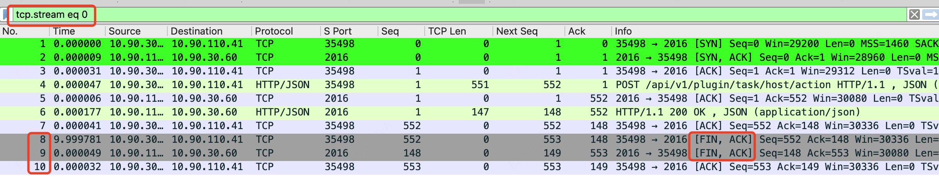
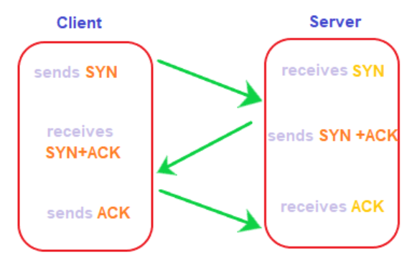
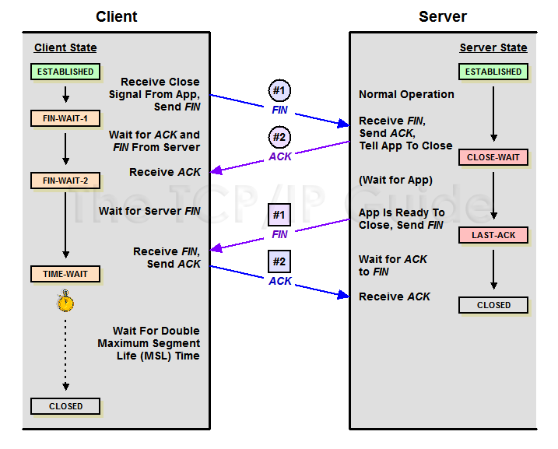
Three Way Handshake

Slide 19
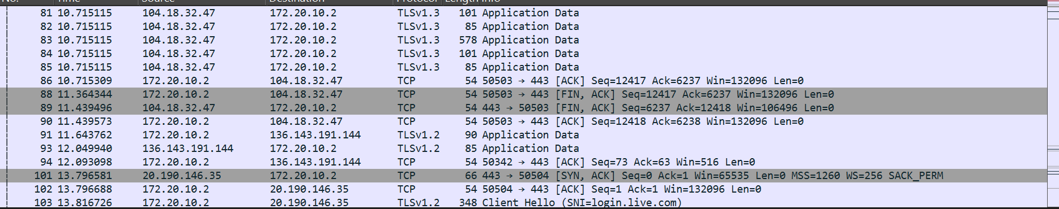

Slide 20
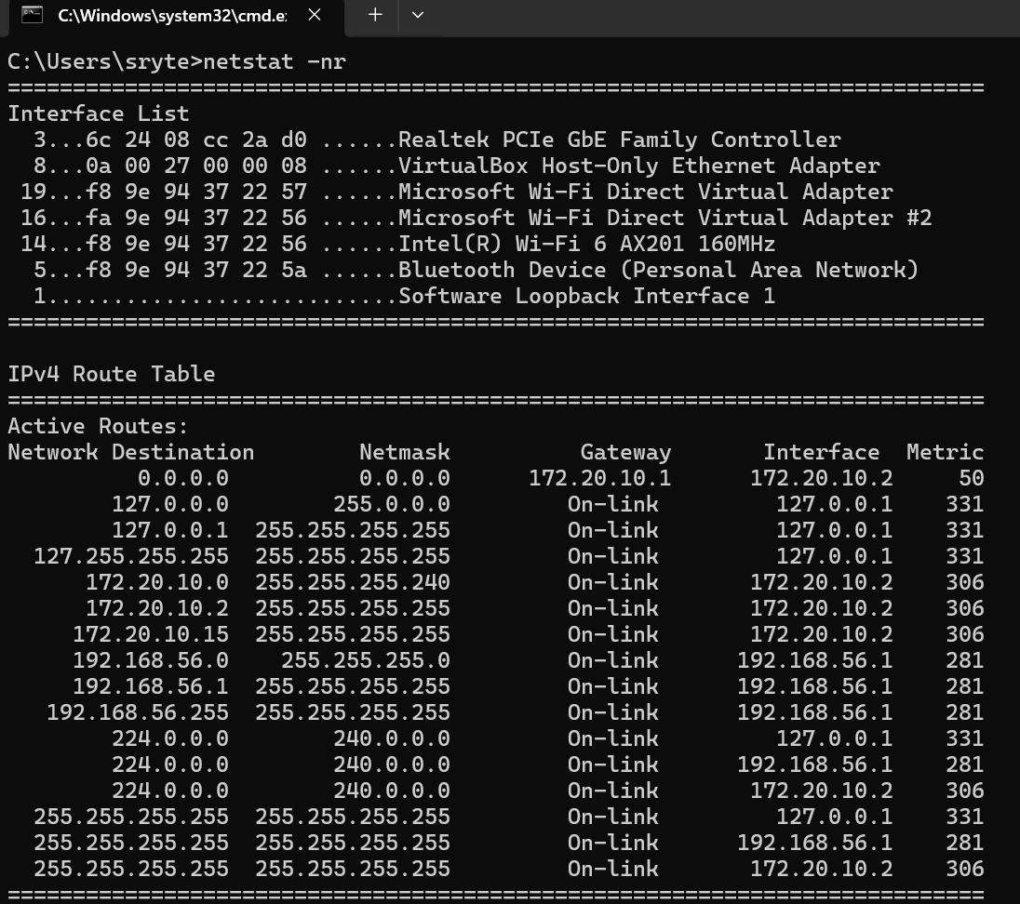
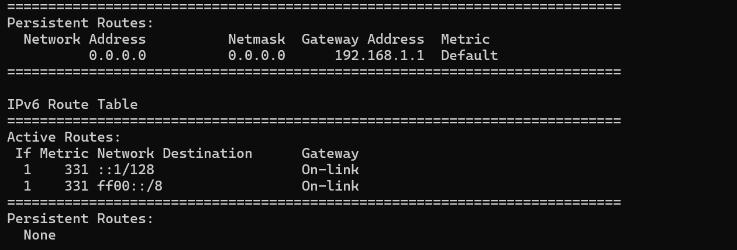
What is Routing Table in Networking?
A Routing Table is an internal table that a computer or router uses to
determine which router interface to send packets to, based on their destination network addresses.

Slide 21
What is Routing Table in Networking?
Network Address: A destination network address on the network
Netmask: The portion of the network address that must match for that route to be used
Gateway Address: Where the packet needs to be forwarded (a local NIC or a local router
interface)
Interface: The address of the NIC through which the packet should be sent
Metric: The number of hops to the destination network
Static Routing:
Static routing is a form of routing that occurs when a router uses a manually-configured
routing entry, rather than information from a dynamic routing traffic. In many cases,
static routes are manually configured by a network administrator by adding in entries
into a routing table, though this may not always be the case. Unlike dynamic routing,
static routes are fixed and do not change if the network is changed or reconfigured.

Slide 22
Dynamic Routing:
Dynamic Routing is a routing mechanism handled by a routing protocol, such as Routing
Information Protocol (RIP) or Open Shortest Path First (OSPF) Protocol, that dynamically
exchanges routing information among routers on an internetwork. Routers that use this
method are called dynamic routers.
How Routing Information Protocol works (RIP Protocols)
RIP uses a distance vector algorithm to decide which path to put a packet on to
get to its destination. Each RIP router maintains a routing table, which is a list of all the
destinations the router knows how to reach. Each router broadcasts its entire routing
table to its closest neighbors every 30 seconds

Slide 23
Dynamic Routing:
Dynamic Routing is a routing mechanism handled by a routing protocol, such as Routing
Information Protocol (RIP) or Open Shortest Path First (OSPF) Protocol, that dynamically
exchanges routing information among routers on an internetwork. Routers that use this
method are called dynamic routers.
How Routing Information Protocol Versions
RIPv1.
RIPv2.
RIPng.
Advantages of RIP
Feasible configuration.
Easy to understand.
Predominantly loop-free.
Guaranteed to support almost all routers.
Promotes load balancing.

Slide 24
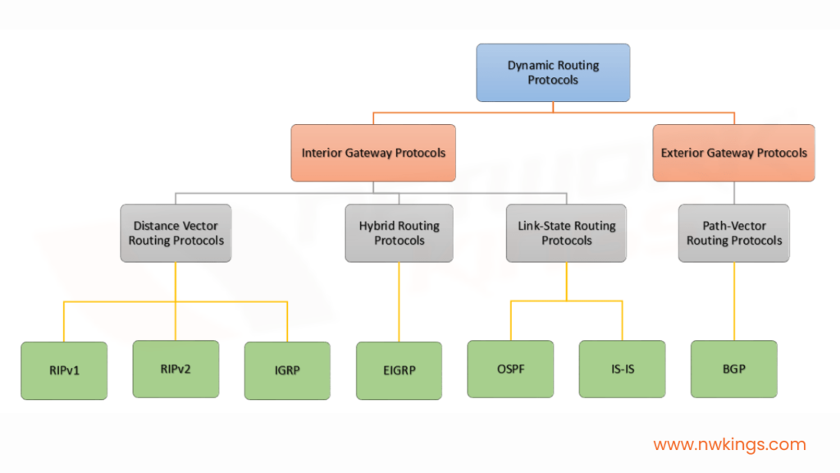

Slide 25
Open Shortest Path First (OSPF) protocol States
Open Shortest Path First (OSPF) is a link-state routing protocol that is used to find the
best path between the source and the destination router using its own Shortest Path First).
OSPF is developed by Internet Engineering Task Force (IETF) as one of the Interior Gateway Protocol
(IGP), i.e, the protocol which aims at moving the packet within a large autonomous system or routing
domain.
Enhanced Interior Gateway Routing Protocol (EIGRP)
EIGRP is a dynamic routing protocol essential for sharing routing information between routers.
It stores routing information about other routers on the network, allowing data to automatically
traverse between network topologies.

Slide 26
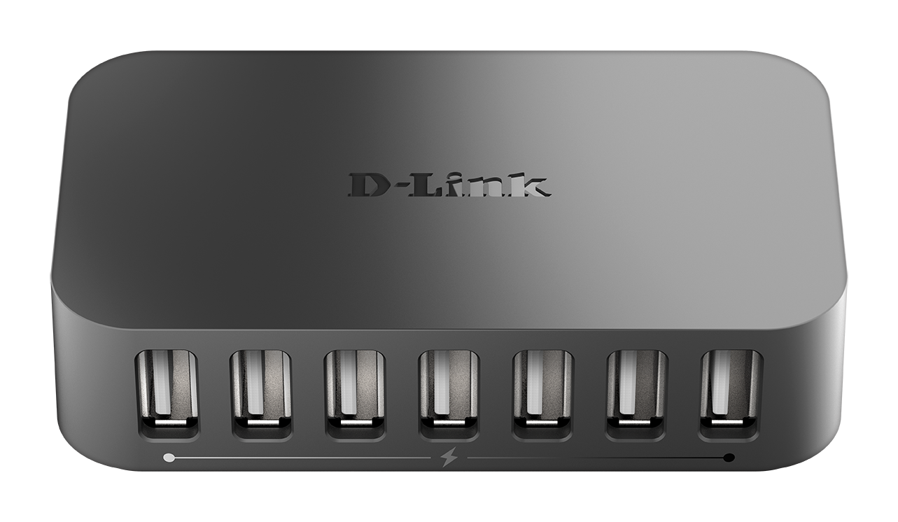
A hub is a multi-port repeater
Hub in networking plays a vital role in data transmission and broadcasting
A hub is a hardware device used at the physical layer to connect multiple devices in the network. Hubs are widely used to connect LANs
Connection to each other when 3 systems will
Connect to 1 and 2 system the collision happened.
Networking Device: HUB
Not Intelligence Device
1 Collision Domain
1 Broadcast Domain

Slide 27
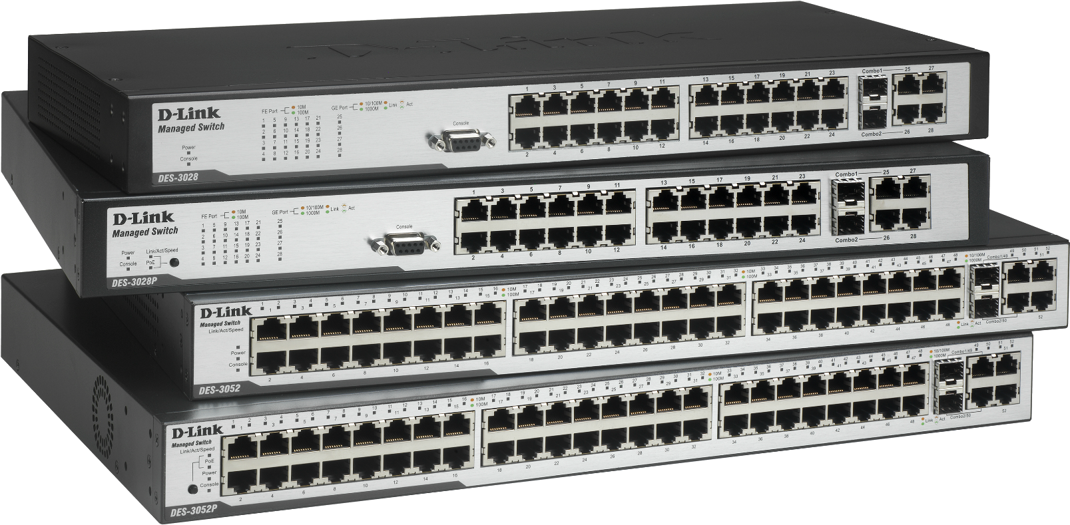
A network switch usually operates at Layer 2 of the OSI model (working with the Ethernet protocol) but there are switch models that implement also routing, which can be considered as Layer 3 devices as well and it has stored the mac address and their port information only.
Switch Type
Fixed Switches
Modular Switches
Stackable Switch
Power over Ethernet (PoE) Switch
Switch with OFC
Unmanaged Switches
Layer 2 and 3 Switches etc.,
Networking Device: SWITCH
Intelligence Device
Many Collision Domain
1 Broadcast Domain

Slide 28
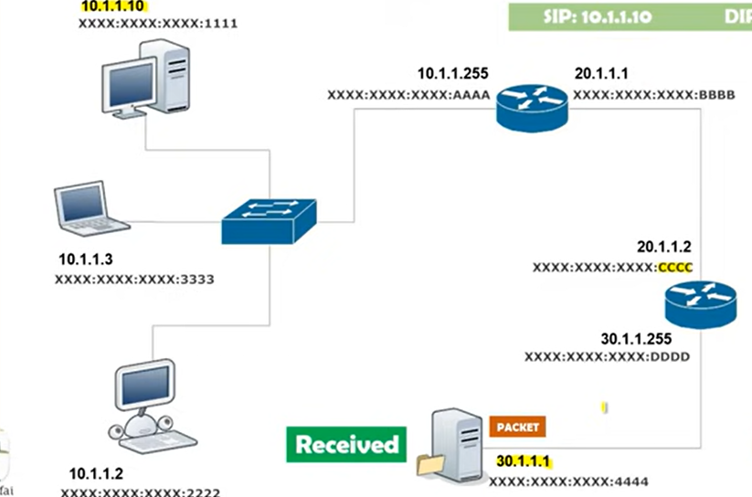
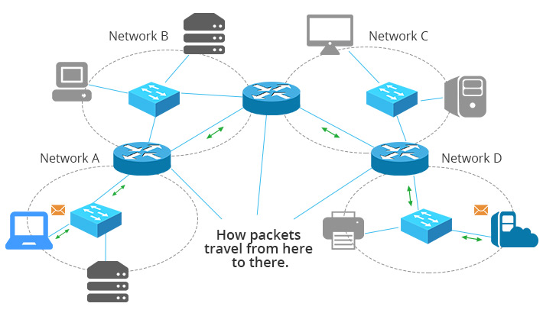
A Router Layer 3 Device
Data transmission happened only using MAC address. In the router having only IP table so Switch will used ARP protocol to get the information about the connected systems then it send an ARP request to all the network and send reply who is having extract MAC Address over the Layer 2 Switch.
Networking Device: Router
Intelligence Device
Many Collision Domain
Many Broadcast Domain

Slide 29
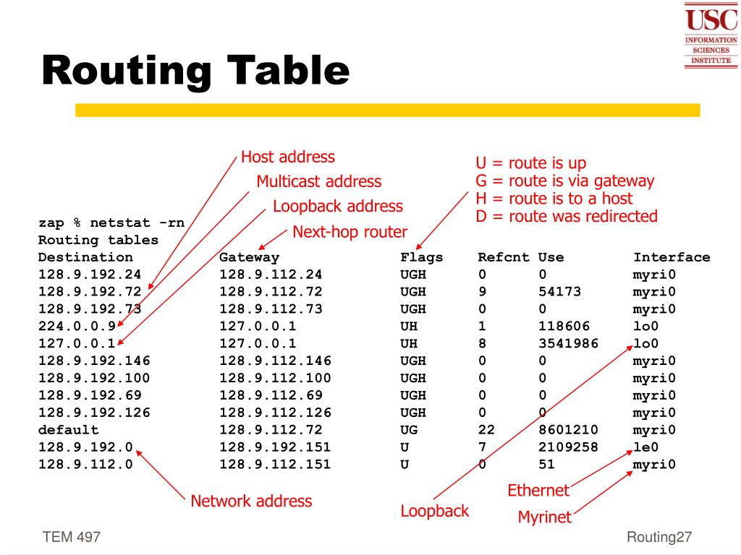

Slide 30
ROUTER Vs SWITCH
Network Layer 3 device | Layer 2 Data Link Layer
Between Computer and Modem | VLAN
Packet Transmitting | Frame (Layer 2), Packet (Layer 3)
Port 2/4/5/8 | 24/48/64
Initially broadcast then Uni-Cast and Multi casting. | First Broadcasting, Uni-Cast, Multi Casting as needed
LAN, WAN, MAN | LAN
Full Duplex (Transmission Mode) | Half Duplex or Full
In router every port has its own broadcast domain | Switch has one Broadcast domain(Unless VLAN Implemented)
IP Address | MAC Address
Connecting two or more Network | Connecting two or more nodes in the same network layer 2 or layer 3
Static and Dynamic Routing | There is no sharing port
NAT Network Address Translation Protocol | None
MAN, or WAN in a router is faster than a layer 3 switches | In a LAN environment an L3 Switches is faster than a router

Slide 31
Troubleshooting Hot Standby Router Protocol (HSRP):
Troubleshooting Hot Standby Router Protocol (HSRP) involves a methodical approach to identify and resolve issues that prevent HSRP from functioning as expected.
Verify HSRP Configurations to ensuring the group numbers on the primary and
Secondary routers must match.
2. To correct virtual IP Address must belong to the same subnet as the physical interface Ips
3. Interface and Connectivity Issues check with traceroute
4. HSRP states and timers like Initial >>> Learn>>>> Listen >>>> Speak>>>> Standby >>Active
5. Check with MAC address table and check active router role.

Slide 32
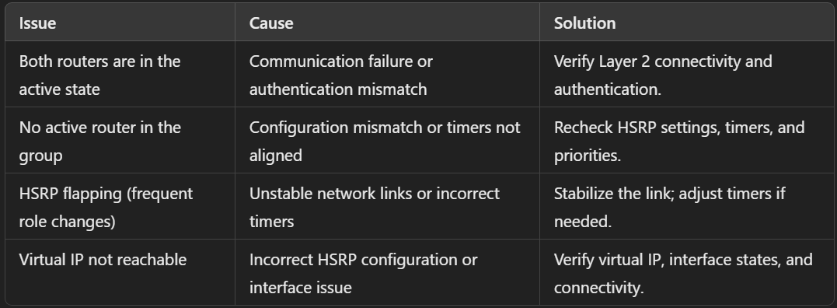
Troubleshooting Hot Standby Router Protocol (HSRP):

Slide 33
Dealing with router problems, troubleshooting security issues, and preventing attacks through mitigation strategies.
Router Problems
Connectivity Issues
Troubleshooting Steps:
Ensure the router is powered on and check for any indicator lights.
Restart the router (power cycle it by unplugging for 30 seconds and plugging back in).
Check physical connections (e.g., Ethernet cables, wall jacks, etc.).
Verify ISP service by connecting directly to the modem if separate.
Mitigation:
Regular firmware updates.
Use a UPS (Uninterruptible Power Supply) for power outages

Slide 34
Dealing with router problems, troubleshooting security issues, and preventing attacks through mitigation strategies.
B. Slow Network Speeds
Troubleshooting Steps:
Check for bandwidth-hogging devices or applications.
Perform a speed test to measure the actual speeds.
Change the router's Wi-Fi channel to avoid interference.
Mitigation:
Upgrade to a router with dual or tri-band capabilities.
Ensure QoS (Quality of Service) settings are optimized.

Slide 35
Dealing with router problems, troubleshooting security issues, and preventing attacks through mitigation strategies.
C. Frequent Disconnects
Troubleshooting Steps:
Check for overheating or excessive device load.
Reset the router to factory settings if the problem persists.
Mitigation:
Use a high-quality router suited for the size and complexity of your network.
Security Issues
Unauthorized Access
Troubleshooting Steps:
Check connected devices via the router admin panel.
Remove unknown devices and change Wi-Fi passwords.
Mitigation:
Use WPA3 encryption for Wi-Fi.
Enable two-factor authentication (2FA) for router admin access.

Slide 36
Dealing with router problems, troubleshooting security issues, and preventing attacks through mitigation strategies.
C. Frequent Disconnects
Troubleshooting Steps:
Check for overheating or excessive device load.
Reset the router to factory settings if the problem persists.
Mitigation:
Use a high-quality router suited for the size and complexity of your network.
Security Issues
Unauthorized Access
Troubleshooting Steps:
Check connected devices via the router admin panel.
Remove unknown devices and change Wi-Fi passwords.
Mitigation:
Use WPA3 encryption for Wi-Fi.
Enable two-factor authentication (2FA) for router admin access.

Slide 37
Dealing with router problems, troubleshooting security issues, and preventing attacks through mitigation strategies.
D. Outdated Firmware
Troubleshooting Steps:
Log in to the router's admin interface and check for updates.
Mitigation:
Enable automatic updates where possible.
Malware-Infected Devices
Troubleshooting Steps:
Isolate the affected device(s) and run antivirus scans.
Mitigation:
Deploy network-level malware detection solutions (e.g., intrusion detection systems).

Slide 38
Dealing with router problems, troubleshooting security issues, and preventing attacks through mitigation strategies.
DDoS Attacks
Mitigation Strategies:
Use routers with built-in DDoS protection features.
Configure firewalls to limit unusual traffic patterns.
Implement rate limiting and IP blocking.
Man-in-the-Middle (MITM) Attacks
Mitigation Strategies:
Use HTTPS and VPNs for secure communication.
Regularly change router admin passwords.

Slide 39
Dealing with router problems, troubleshooting security issues, and preventing attacks through mitigation strategies.
Phishing and Social Engineering
Mitigation Strategies:
Educate users on recognizing suspicious emails or links.
Implement email filters and secure browsing practices.
Weak Default Configurations
Mitigation Strategies:
Disable unnecessary services (e.g., WPS, UPnP).
Regularly review and strengthen router settings.

Slide 40
Dealing with Switch problems, troubleshooting security issues, and preventing attacks through mitigation strategies.
Switch Problems
1. Connectivity Issues
Troubleshooting Steps:
Check for faulty cables or loose connections.
Verify that the port status LEDs are active (indicating a good connection).
Test with different ports or cables to rule out hardware issues.
Use commands like ping or traceroute to test connectivity.
Mitigation:
Perform regular physical inspections of cables and ports.
Maintain a spare stock of cables and transceivers for quick replacements.

Slide 41
Dealing with Switch problems, troubleshooting security issues, and preventing attacks through mitigation strategies.
Configuration Errors
Troubleshooting Steps:
Verify VLAN configurations, ensuring devices are in the correct VLANs.
Use commands like show running-config (Cisco) to review settings.
Check for mismatched trucking protocols (e.g., mismatched 802.1Q).
Mitigation:
Implement standardized configuration templates.
Use configuration backups and regularly audit them.

Slide 42
Dealing with Switch problems, troubleshooting security issues, and preventing attacks through mitigation strategies.
Security Issues
1. Unauthorized Access
Troubleshooting Steps:
Check for unauthorized devices connected to the switch.
Monitor MAC address tables for unfamiliar entries using commands like
show mac address-table.
Mitigation:
Enable port security to restrict the number of allowed MAC addresses per port.
Disable unused ports or place them in an unused VLAN.

Slide 43
Dealing with Switch problems, troubleshooting security issues, and preventing attacks through mitigation strategies.
Vulnerable Management Access
Troubleshooting Steps:
Verify that management access protocols (SSH, Telnet) are secured.
Mitigation:
Use SSH instead of Telnet for encrypted management.
Restrict access to management interfaces using Access Control Lists (ACLs).
3. Outdated Firmware
Troubleshooting Steps:
Verify firmware version using the switch's admin console or CLI.
Mitigation:
Schedule regular updates and ensure backup configurations before upgrades.

Slide 44
Dealing with Switch problems, troubleshooting security issues, and preventing attacks through mitigation strategies.
Preventing Attacks
1. ARP Spoofing/Poisoning
Mitigation Strategies:
Enable Dynamic ARP Inspection (DAI) to verify ARP packets.
Use static ARP entries for critical devices where possible.
2. VLAN Hopping
Mitigation Strategies:
Disable automatic trunk negotiation (turn off DTP on ports that don’t require it).
Assign unused ports to an isolated VLAN.
Use VLAN access lists (VACLs) to filter unauthorized traffic.
3. MAC Flooding
Mitigation Strategies:
Enable port security to limit the number of allowed MAC addresses per port.
Use features like "storm control" to manage broadcast and multicast traffic.
4. Unauthorized Remote Access
Mitigation Strategies:
Use RADIUS/TACACS+ for centralized authentication.
Enable logging and alerts for management access attempts.

Slide 45
Dealing with Switch problems, troubleshooting security issues, and preventing attacks through mitigation strategies.
5. Denial of Service (DoS)
Mitigation Strategies:
Configure rate limiting to prevent excessive traffic.
Implement access control lists to block suspicious sources.
6. Physical Security
Mitigation Strategies:
Place switches in secured, locked areas to prevent physical tampering.
Use port-based authentication protocols like 802.1X to verify devices.

Slide 46
Common Bandwidth and Traffic Issues
Congestion or Slow Speeds
Unbalanced Traffic Distributions
Unusual Traffic Patterns like malware and spyware activity
Packet Loss or Latency
Troubleshooting Issues:
Analysis Network Traffic (Wireshark, NetFlow, or Networking Monitoring Tools) – Identify high-bandwidth users or devices.
Determine top protocols or applications consuming bandwidth.
Look for unusual traffic patterns.

Slide 47
Troubleshooting Issues:
Test Bandwidth
Run Speed Tests:
Measure the actual speed on devices.
Compare results with the expected performance from your ISP.
Isolate Segments:
Test bandwidth between switches, routers, and endpoints to pinpoint the bottleneck.
3. Verify QoS Settings
Check for QoS misconfigurations that may deprioritize critical traffic.
Ensure priority is assigned to time-sensitive applications (e.g., VoIP, video conferencing).
Inspect Physical Connections
Check Ethernet cables, ports, and connections for faults or damage.
Replace cables or swap ports to rule out hardware issues.
5. Monitor for Traffic Spikes
Log Analysis:
Check router and switch logs for unusual traffic from specific IPs or MAC addresses.
Mitigation:
Block or throttle the offending IP/device.
Scan for malware on affected devices.

Slide 48
Troubleshooting Issues:
Adjust Bandwidth Allocation
Router/Switch Configuration:
Apply traffic shaping or bandwidth limits on non-critical devices.
Reserve bandwidth for critical applications using QoS policies.
Inspect and Configure Firewalls
Check firewall rules for misconfigured or open policies that allow unnecessary traffic.
Block suspicious or high-bandwidth traffic sources.
Preventative and Mitigation Technologies / Strategies
Optimize Network Performance
Regularly review and optimize VLANs for efficient traffic segmentation.
Use link aggregation (LACP) for high-traffic segments to combine multiple Ethernet links.
Implement Monitoring Tools
Deploy real-time monitoring tools to continuously analyze traffic patterns.
Set up alerts for traffic anomalies or bandwidth exhaustion.
Limit Bandwidth Usage
Enable traffic shaping for non-essential applications (e.g., streaming, social media).
Set bandwidth caps for guest networks.

Slide 49
Preventative and Mitigation Technologies / Strategies
Secure the Network
Prevent Misuse:
Restrict access to critical network segments using ACLs.
Deploy 802.1X port security to control device access.
DDoS Protection:
Use rate limiting and intrusion prevention systems (IPS) to handle malicious traffic.
Upgrade Infrastructure
If bandwidth limitations persist:
Upgrade to higher-capacity switches or routers.
Increase ISP bandwidth to match network demands.
Educate Users
Inform users about acceptable bandwidth usage policies.
Encourage users to schedule large file transfers during off-peak hours.

Slide 50
Feature of NetFlow
Traffic Monitoring (Bandwidth usage, Source and Destination Ips, Ports
and applications).
Traffic Analysis
Anomaly Detections (Detect unusual traffic patterns, such as potential DDOS attacks, port scans, or unauthorized access attempts)
Historical Data (Stores traffic flow information for retrospective analysis, aiding in long-term network planning and post- incident forensics investigations).
How NetFlow Works:
Source and destination IP addresses.
Source and destination ports.
Protocol (TCP/UDP).
Type of Service (ToS) field.
Input interface.

Slide 51
Tools of NetFlow
NetFlow Tools
Popular tools to collect and analyze NetFlow data include:
SolarWinds NetFlow Traffic Analyzer: Comprehensive traffic and performance monitoring.
ManageEngine NetFlow Analyzer: Focuses on bandwidth monitoring and analysis.
nProbe/nTop: Lightweight and efficient for real-time traffic visualization.
Wireshark: Can analyze NetFlow exports for packet-level troubleshooting.

Slide 52
Troubleshooting Configuration Issues
Common Configuration Issues
Incorrect Network Settings
Firewall and ACL Errors
Authentication Failure (RADIUS, TACACS+, Incorrect username and passwords or misconfigured authentication protocols)
Routing Configurations
Device Misconfiguration like speed, duplex mismatches.
Troubleshooting Tips by configuration Area:
Network Configurations
Firewall and ACL Configurations
QoS Policies
Routing Configurations
Authentications Configurations

Slide 53
Quick Troubleshooting Commands
Area | Command | Purpose
VLANs | show vlan brief | Display VLAN memberships.
IP Routing | show ip route | Verify routing table entries.
Interfaces | show interfaces status | Check interface status and configuration.
Spanning Tree | show spanning-tree | Review STP settings and root bridges.
Firewall/ACL | show access-lists | Review applied access control rules.
Logging | show logging | Examine logs for error messages.
Authentication | debug aaa authentication | Trace authentication processes.

